Slide 1
Project On “Customer Retention”
Presented by Shalini roy

Slide 2
index:
Outline
Problem Statement
Why Customer Retention Important?
Exploratory data analysis
Visualization
Conclusion

Slide 3
outline
Here is the study of customer retention dataset which is collected from the Indian online shoppers. It is an overview of the e-retail success, which are important for customer satisfaction:-
Customer Retention Criteria
Complete Problem analysis
Conclusion for betterment

Slide 4
Problem Statement
Customer satisfaction has emerged as one of the most important factors that guarantee the success of online store; it has been posited as a key stimulant of purchase, repurchase intentions and customer loyalty. A comprehensive review of the literature, theories and models have been carried out to propose the models for customer activation and customer retention. Five major factors that contributed to the success of an e-commerce store have been identified as: service quality, system quality, information quality, trust and net benefit. The research furthermore investigated the factors that influence the online customers repeat purchase intention. The combination of both utilitarian value and hedonistic values are needed to affect the repeat purchase intention (loyalty) positively.

Slide 5
Why customer Retention important?
Keeping customers is more cost effective for businesses than finding new ones, so customer retention is a priority for most organizations. Customer retention refers to a group of strategies used by a company to enhance the proportion of returning customers and the profitability of each individual client. Utilizing customer retention tactics enables you to give and receive more value from your existing customer base. You want to make sure the clients you've worked so hard to get will stick around, enjoy doing business with you, and continue to find value in your offerings.

Slide 6
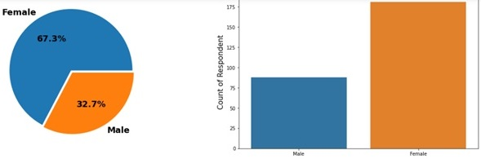
Exploratory data analysis Data visualization

Slide 7
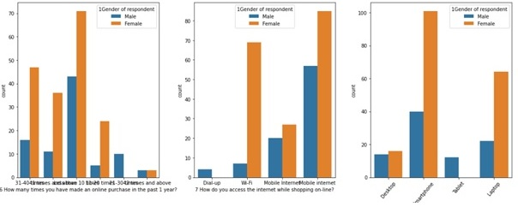
Exploratory data analysis Data visualization

Slide 8
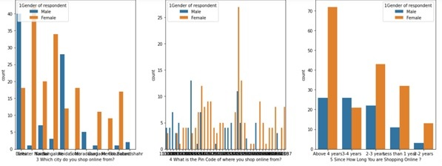
Exploratory data analysis Data visualization

Slide 9
Exploratory data analysis Observations of the data analysis in pie plot and bar plot.
Female customers are maximum with 66.9%
From 51 and above age group of customer are Male
Approximate 70% customers are using mobile internet
Maximum customer are from Delhi followed by Greater Noida
Max user are use Google Chrome as their browser followed by safari.

Slide 10
Exploratory data analysis
Mozilla Firefox is used only by device with 5 inch screen size.
Content marketing and display Advert is less popular than Search Engine
Content Marketing is mainly access by IOS/Mac user.
Max laptop have Window OS
171 customer sometimes abandon shopping cart.
The customer who explore less than 5 mins before making purchase have very less tendency to abandon cart.
It can conclude that the website is more popular to the young aged customer as all the response from them are very positive form all aspects.
90% customer are agreed that User satisfaction cannot exist without trust.
54.3 % customer are strongly agreed that Shopping online is convenient and flexible

Slide 11
Conclusion
Benefit of Flipkart is fast delivery of products and convenient to use
Max customers says that, Myntra has the drawback of having late declaration of price.
The most reliable website from different parameter is Amazon. But still it need to do some improvement like disturbance free shopping experience during promotion, corresponding product price early during promotion, Need to give more payment options to customers etc.
Delivery time of Paytm need to reduce.
Max customers uses there debit/credit cards for there payment.
Paytm and Snapdeal has maximum drawbacks it is because of their dead old strategies
Snapdeal and Paytm have many drawbacks of having limited payment modes, not much secure, liable and also they have a complaint of late delivery.

Slide 12


